Slide 1
4th Grade’s Current Schedule
8:45-9:15 Arrival Time
9:20-11:20 EL (Reading and Writing)
11:20-11:50 Lunch
11:50-12:25 Recess
12:30-1:00 Intervention/Enrichment
1:00-2:00 Math
2:00-2:45 Specials
2:45-3:30 Science/Social Studies (snack)
3:30-3:45 Social and Emotional Learning (SEL)

Slide 2
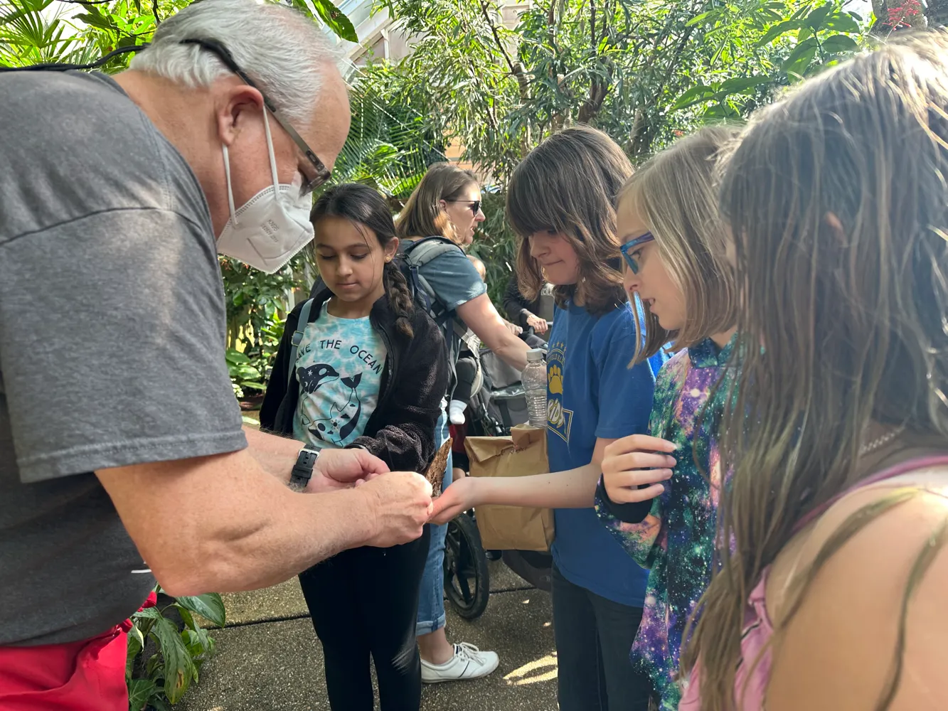
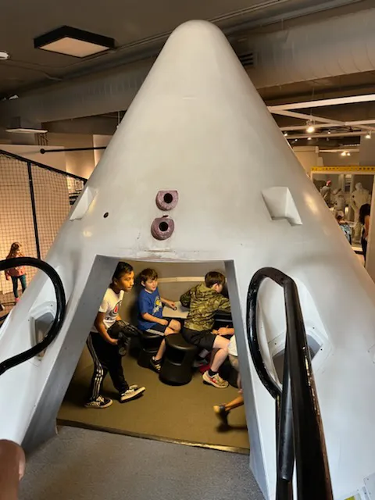
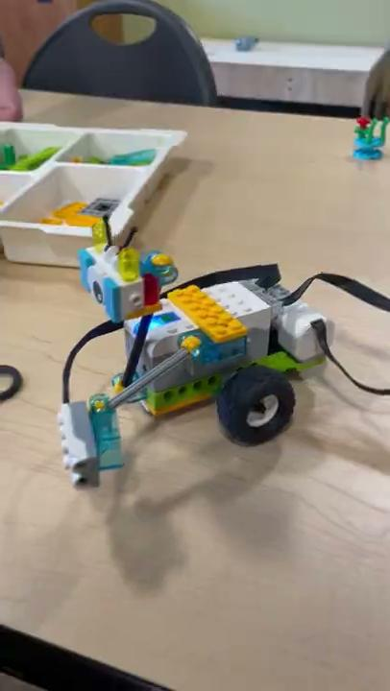
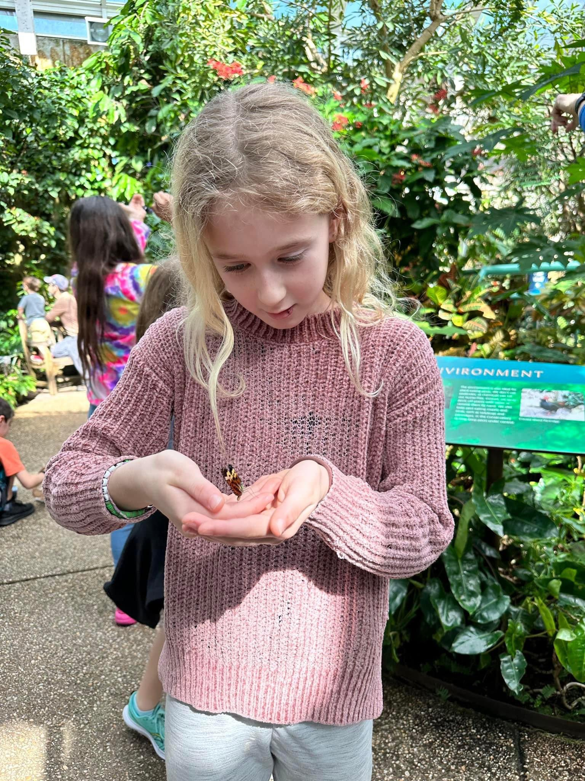
4th Grade Field Trips
Roller Skating
And
Durham’s Life and Science Museum

Slide 3
Fourth grade is an EXCITING year in your child’s education. In READING AND WRITING, we focus on four major topics using the science of reading:
Poetry and what inspires someone to write
Animal behaviors and animal defense mechanisms
Understanding different perspectives during the American Revolution
Responding to social injustice and inequality
Each quarter, we will be reading a variety of nonfiction and fiction texts and then have a cumulative writing project to apply our knowledge by incorporating text evidence and creativity. We also continue to focus on decoding words by building our knowledge of affixes, a variety of grammar and usage skills, and develop our speaking and listening skills.

Slide 4
In MATH, your child will explore and focus on these topics:
Place value strategies to add and subtract whole numbers
Collect and analyze data
Explore multiplicative comparisons, factors, area and perimeter
Develop multiplication and division strategies
Extend the understanding of fractions
Connect decimal notation
Understand operations with fractions and decimals
Apply geometric concepts
Use place value to understand metric measurement
For each unit, students will establish mathematics goals to focus learning, implement tasks that promote reasoning and problem solving, use and connect mathematical representations, facilitate meaningful mathematical discourse, pose purposeful questions, build procedural fluency from conceptual understanding, elicit and use evidence of student thinking.

Slide 5
In SCIENCE, students will investigate to following topics in fourth grade:
Food: vitamins, minerals and exercise
Force and motion: magnets and electric charge
Forms and interactions of energy
Matter, rocks and minerals
Earth's changing history
Patterns of Earn and its moon
Life in changing habitats
In SOCIAL STUDIES, will examine and explore a wide variety of topics about North Carolina:
The growth and development of North Carolina
The history of North Carolina
Impact of people in North Carolina
Personal financial decisions

Slide 6
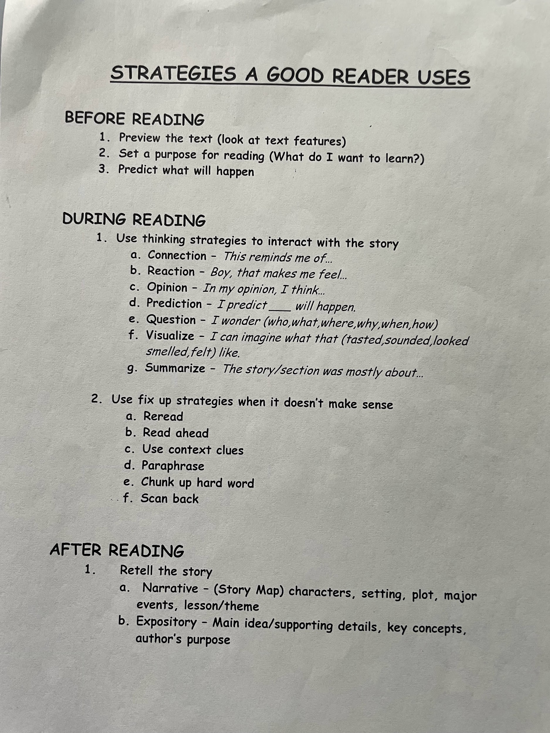
How you can help your student at home with reading

Slide 7
How you can help your student at home with math
Practice your multiplication facts!
We encourage your child to memorize facts before 4th grade!

Slide 8
